Slide 1

CSE 163
Numpy + Images
Hunter Schafer

Slide 2
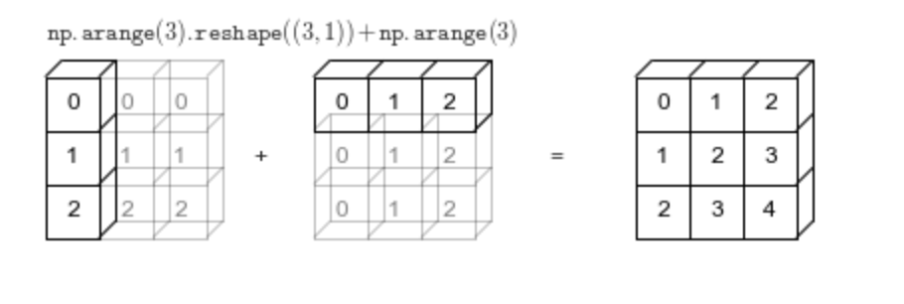
What
Happened?
a.shape = (3, 1)
b.shape = (3,)
a.shape = (3, 1)
b.shape = (1, 3)
a.shape = (3, 3)
b.shape = (3, 3)

Slide 3
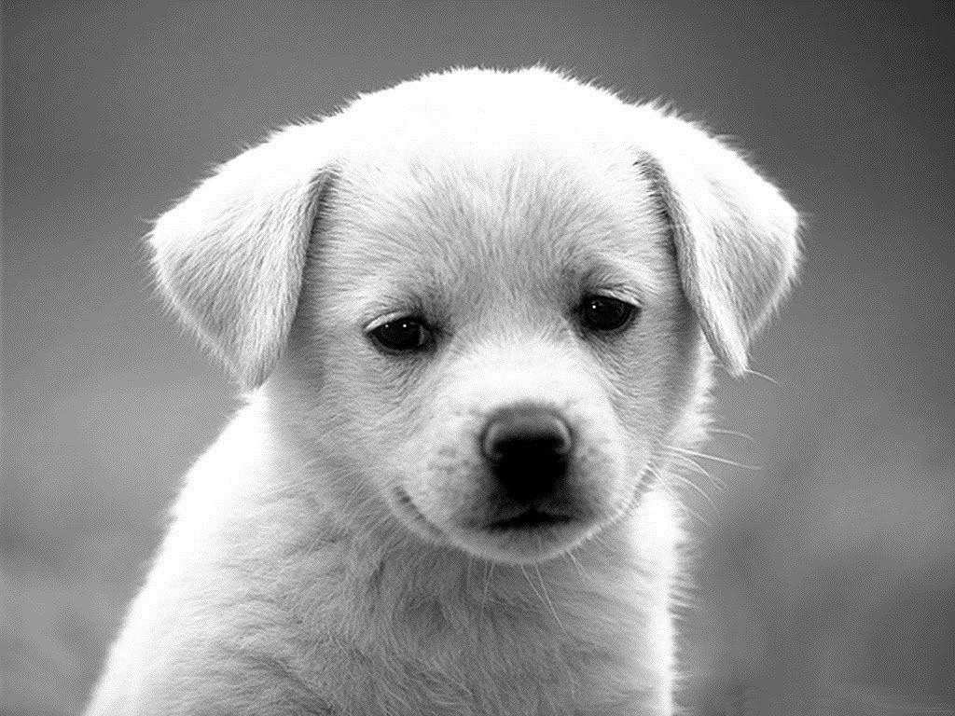
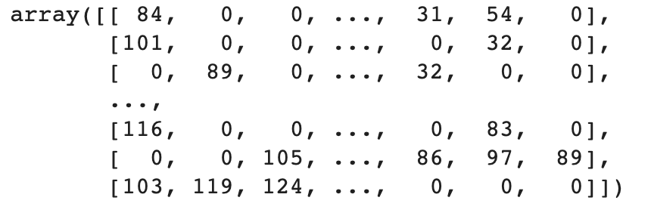
Images as
Matrices
Grey-scale images can be represented as matrices.
Grey-scale: 255
Grey-scale: 0

Slide 4
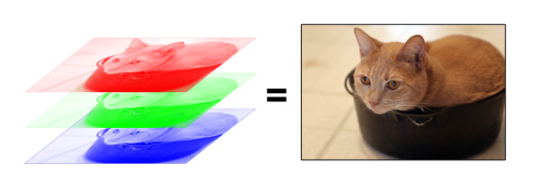
Color Images
When you overlap each color channel, it creates a picture we are used to seeing.
Pixels on your monitor let out specified R/G/B light

Slide 5
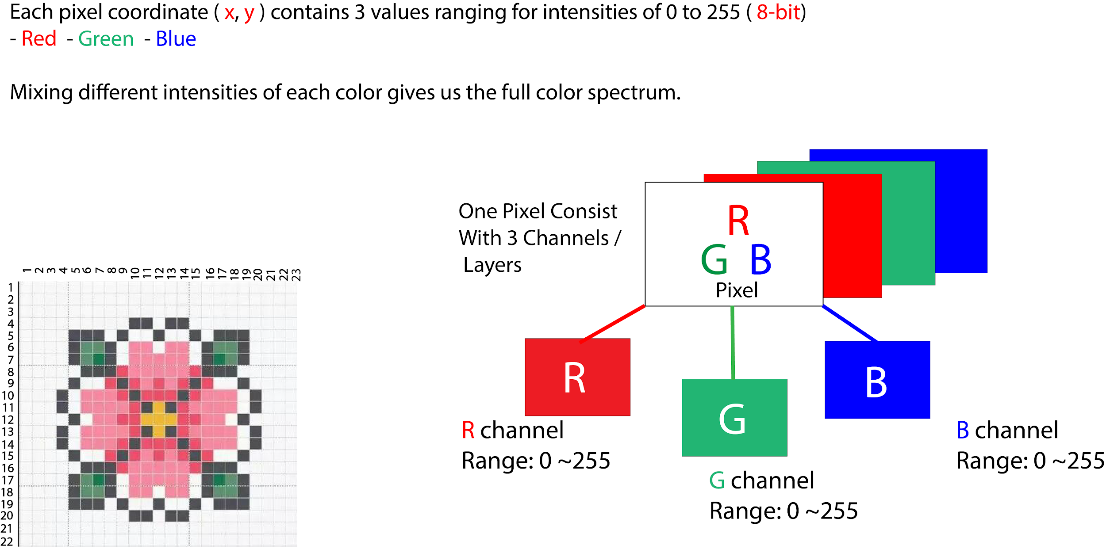
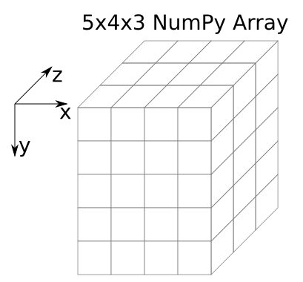
Color Images

Slide 6
Color Demo
Colab
Goal: Manipulate image values to change color of image
Show how changing colors changes image
Write a method to “circle” object in the middle of a picture
Note
Often “global” transformations of an image can be done without loops, probably speeding up the program

Slide 7
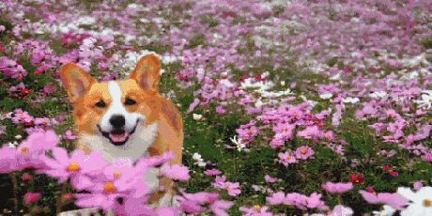
Brain Break

Slide 8
Convolution
When wanting to use “local” information, we need to use a sliding window approach (i.e. a convolution)
Move the sliding window across the image, and compute the sum of the element wise product of the window (kernel) and image
Image
3 | 3 | 2 | 1 | 0
0 | 0 | 1 | 3 | 1
3 | 1 | 2 | 2 | 3
2 | 0 | 0 | 2 | 2
2 | 0 | 0 | 0 | 1
Kernel
0 | 1 | 2
2 | 2 | 0
0 | 1 | 2

Slide 9
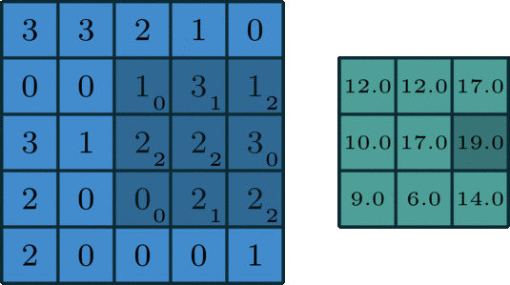
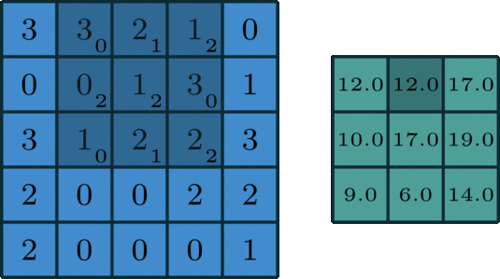
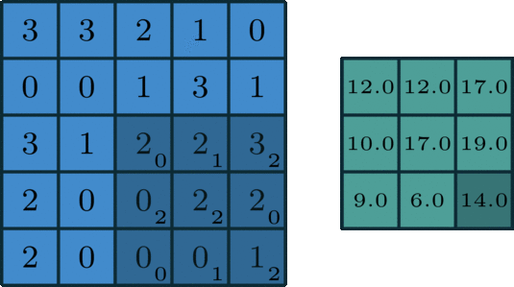
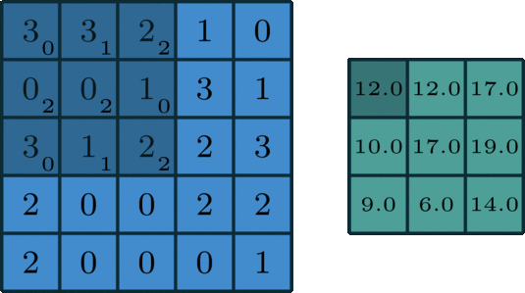
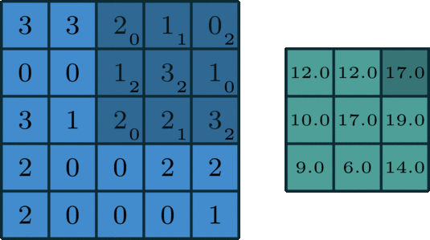
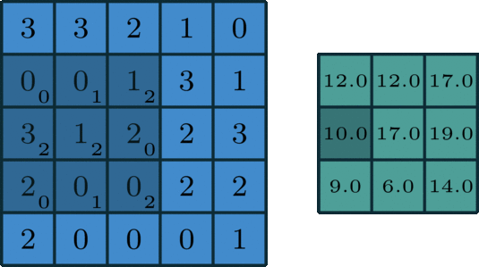
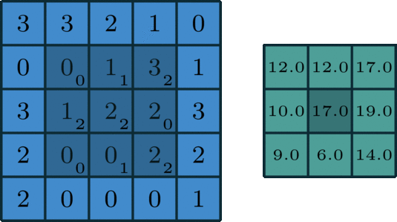
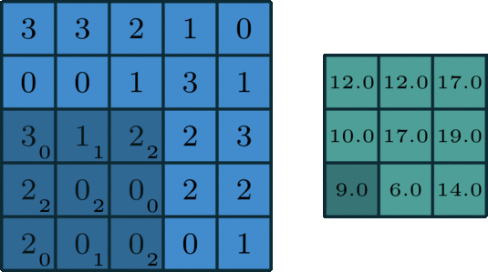
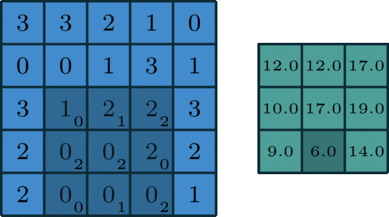
Convolution Example

Slide 10
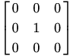
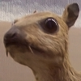
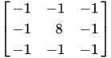

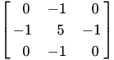
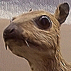
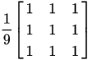

Common Kernels
What do the numbers in the kernel do?
Identity
Edge Detection
Sharpen
Box Blur

Slide 11
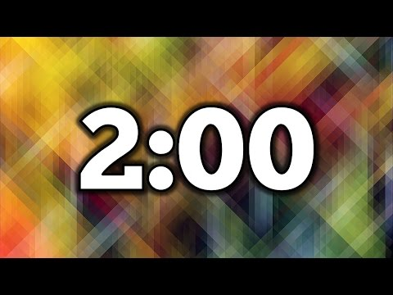
1 minute
What is the result of applying a convolution using this kernel on this image?
Image
Kernel
1 | 2 | 3
4 | 5 | 6
7 | 8 | 9
1 | 1
0 | 2

Slide 12
1.5 minutes
What is the result of applying a convolution using this kernel on this image?
Image
Kernel
1 | 2 | 3
4 | 5 | 6
7 | 8 | 9
1 | 1
0 | 2

Slide 13
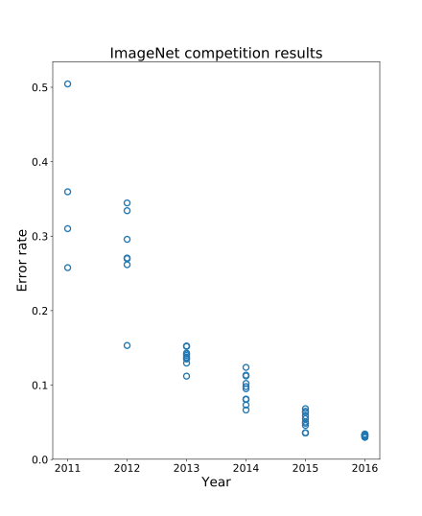
Image Classification
For a really long time, image classification was done by painstakingly crafting these features (like edge detectors), by hand.
This kind of worked, but we quickly hit our peak using this method.
Then came the buzz-word… deep learning

Slide 14

Convolutional Neural Networks
Has layers that perform functions like a convolution or classification
Each layer is connected to the next (network)
Specifics are not important here, just general idea of learning kernels

Slide 15

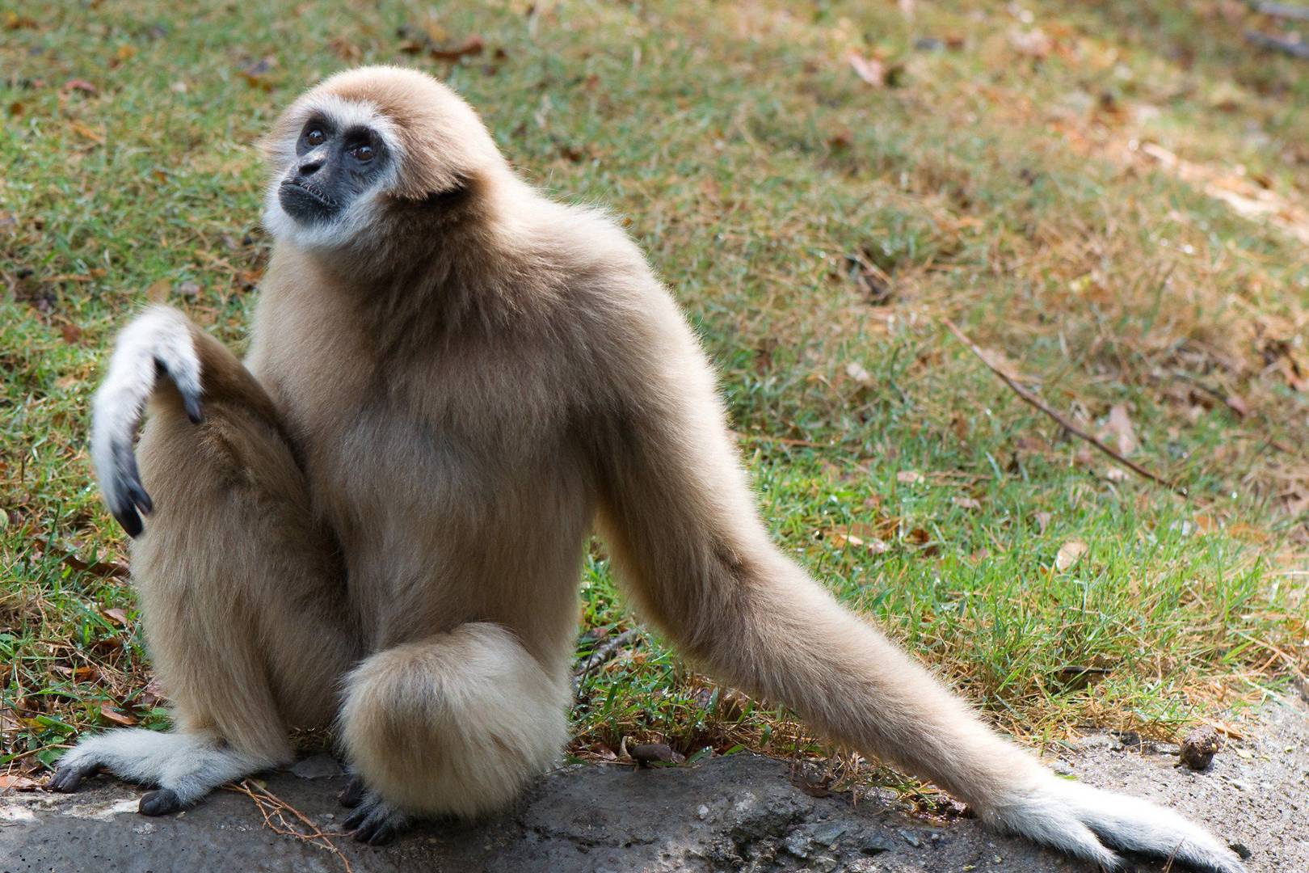
Image Classification
Is this a solved problem?
We get pretty decent error rates on challenges like ImageNet
What we can’t do
Sometimes can’t generalize to other real-world datasets
Adversarial attacks

Slide 16
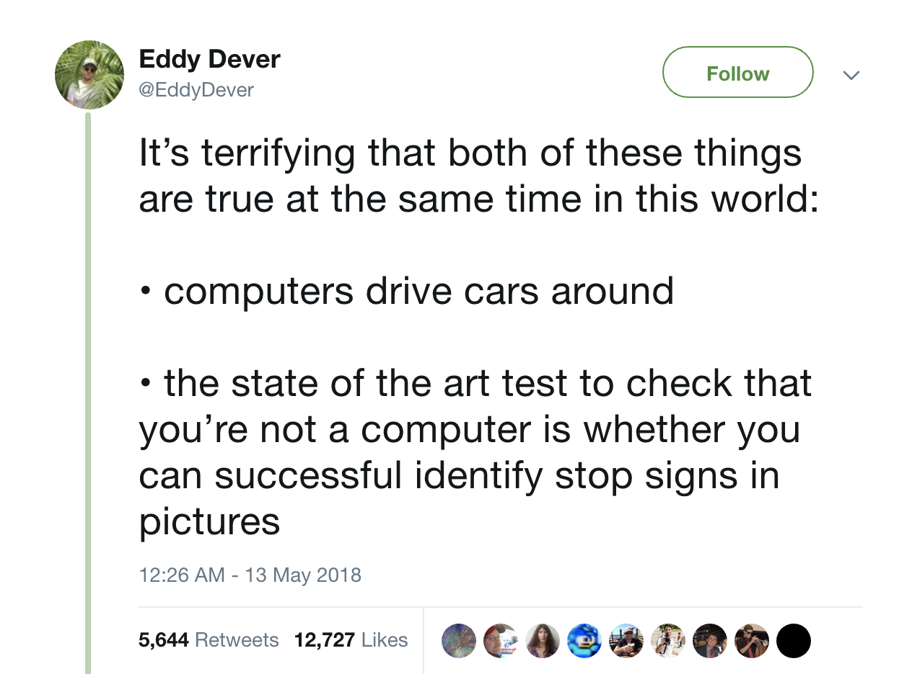

Slide 17
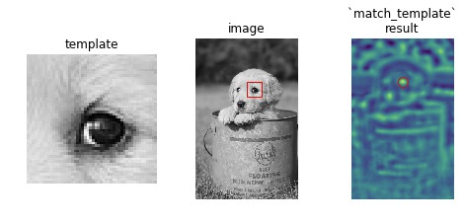
Why Convolutions?
A fundamental operation for image processing that shows up in many applications
Edge detection
Convolutional Neural Networks (CNN)
Template Matching - Your Homework

